Slide 1
Topic Modelling: Can an ML model guess what a document is about?
Made with your Laziness in Mind

Slide 2
Problem Statement:
Given a document, we would like our model to classify it under one or more specific topic(s)
By topic, we mean a cluster of words with a common underlying “theme”
Ideally, we want these words to be related semantically with a unifying theme that is meaningful in a way humans can appreciate, although our model only groups these words and topics based on occurrence probabilities.
We can quantify whether or not our model choose topics and associated words in a way that “makes sense” to us humans by using a metric called “coherence” (more on this later! For now stay on your toes)

Slide 3
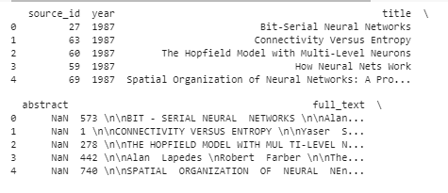
The Dataset:
The dataset includes 9,680 research papers collected between 1987 to 2019 from the Neural Information Processing Systems (NeurIPS) conferences. They are held every December and consist of talks and workshops that discuss machine learning, artificial intelligence, statistics, computational neuroscience…
The dataset after some pandas.read_csv magic

Slide 4
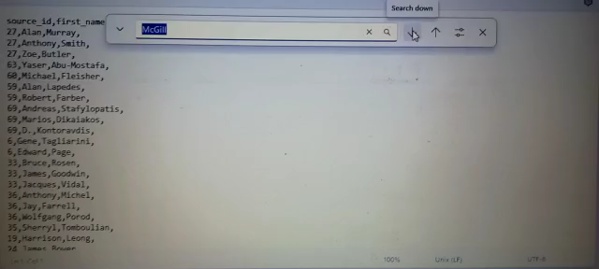
Spot Your Prof
Quite a lot of McGill professors published in NeurIPS!

Slide 5

Preprocessing
Tokenization
Stop Words
Broke down the text of each document to a list of words
Lowercased strings, removed numbers, punctuation, special characters, and words shorter than 3 letters
Filtered out commonly used words such as “an”, “the”, “for”. “other”, “which”, “yourself”…
Made my own custom stop words specific to my dataset and filtered them too: “et al”, “university”, “assume”, “label”, “compute”…
Lemmatization
Converted words back into their lemmas, or root forms: e.g. “studying”, “studies”, and “studied” all become “study”
Creating N-grams
We would like our model to distinguish between individual words i.e. “machine” and “learning”, and those same words that create a different meaning when grouped together consecutively i.e. “machine learning”. This is called a bigram, and has a different semantic value than either of the words when used alone. My model detects these n-grams based on the co-occurrence frequencies of the words and begins to treat them as a single word

Slide 6
Train-Test Split
Dataset was split into 80% training and 20% testing to give the model as robust a training set as possible for it to learn the underlying topics while setting aside some documents to help evaluate its performance on unseen data. The split was completely random with no bias towards the year a paper was published. This is important since Machine Learning has always been an evolving field, so papers published in earlier years may have been completely lacking in topics discovered only in later years. The split ensures that all possible topics and words have equal “representation” in the training set otherwise the model will not “know” how to assign topics and word clusters to a document in the test set whose word vocabulary has never been encountered during training.

Slide 7
Title and Content Layout with Chart

Slide 8
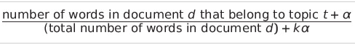
What’s Going on Under the Hood?
All of LDA can be condensed into 3 (friendly!) formulae:

Slide 9
Evaluating the LDA Model

Slide 10
The Limitations of LDA

Slide 15
Two Content Layout with Table
First bullet point here
Second bullet point here
Third bullet point here
Class | Group 1 | Group 2
Class 1 | 82 | 95
Class 2 | 76 | 88
Class 3 | 84 | 90

Slide 27
Why do we even care about topic modelling?

Slide 28

Thank you for making it this far without dozing off!
If you understood none of that, scan me to learn more
Clara Riachi
Department of Mathematics & Computer Science
McGill University

